Slide 1
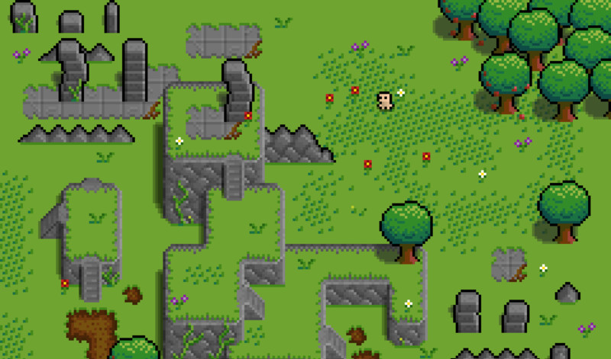

Green Sky Games
1 Bidhan / 2 Todd / 2+Alex / 3 Mark / 4 Shan / 5 Hengyi / 6 Liz

Slide 2

TABLE OF CONTENTS
01
04
02
05
03
06
Game Story
Data Flow Diagrams
About Us
Global Use Case
Storyboard
IndividualUse Case

Slide 3
01
Game Story
You could enter a subtitle here if you need it

Slide 4
BREAKING RED

Slide 5
— Countless forest animals asked
“Who killed
Little Red Riding Hood’s Grandmother?”

Slide 6
OUR GOALS
Story
Combat
Scenery
A cohesive story that follows the main character, a parody of Little Red Riding Hood.
Red will be able to fight her foes in the forest wielding her trusty walking stick.
The forest of Red’s youth will be an explorable scene where the forest denizens hide.

Slide 7
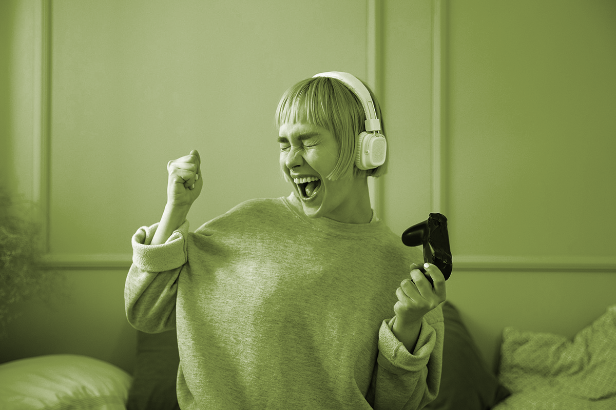
The Story of Breaking Red
“Once upon a time, Little Red Riding Hood visited her Grandmother’s house, only to find her… murdered. Who could have committed such a heinous act in the forest that Red grew up in?”

Slide 8
The Story of Breaking Red
“No longer the scared girl of her youth, it’s up to Red to find out who killed Grandmother and bring them down.”

Slide 9
02
About Us
Hello, from Green Sky Games!

Slide 10
OUR TEAM
Bidhan
Todd
Alex
TL1
TL2
TL2+
Mark
Shan
Hengyi
Liz
TL3
TL4
TL5
TL6

Slide 11
03
Storyboard
You could enter a subtitle here if you need it

Slide 12
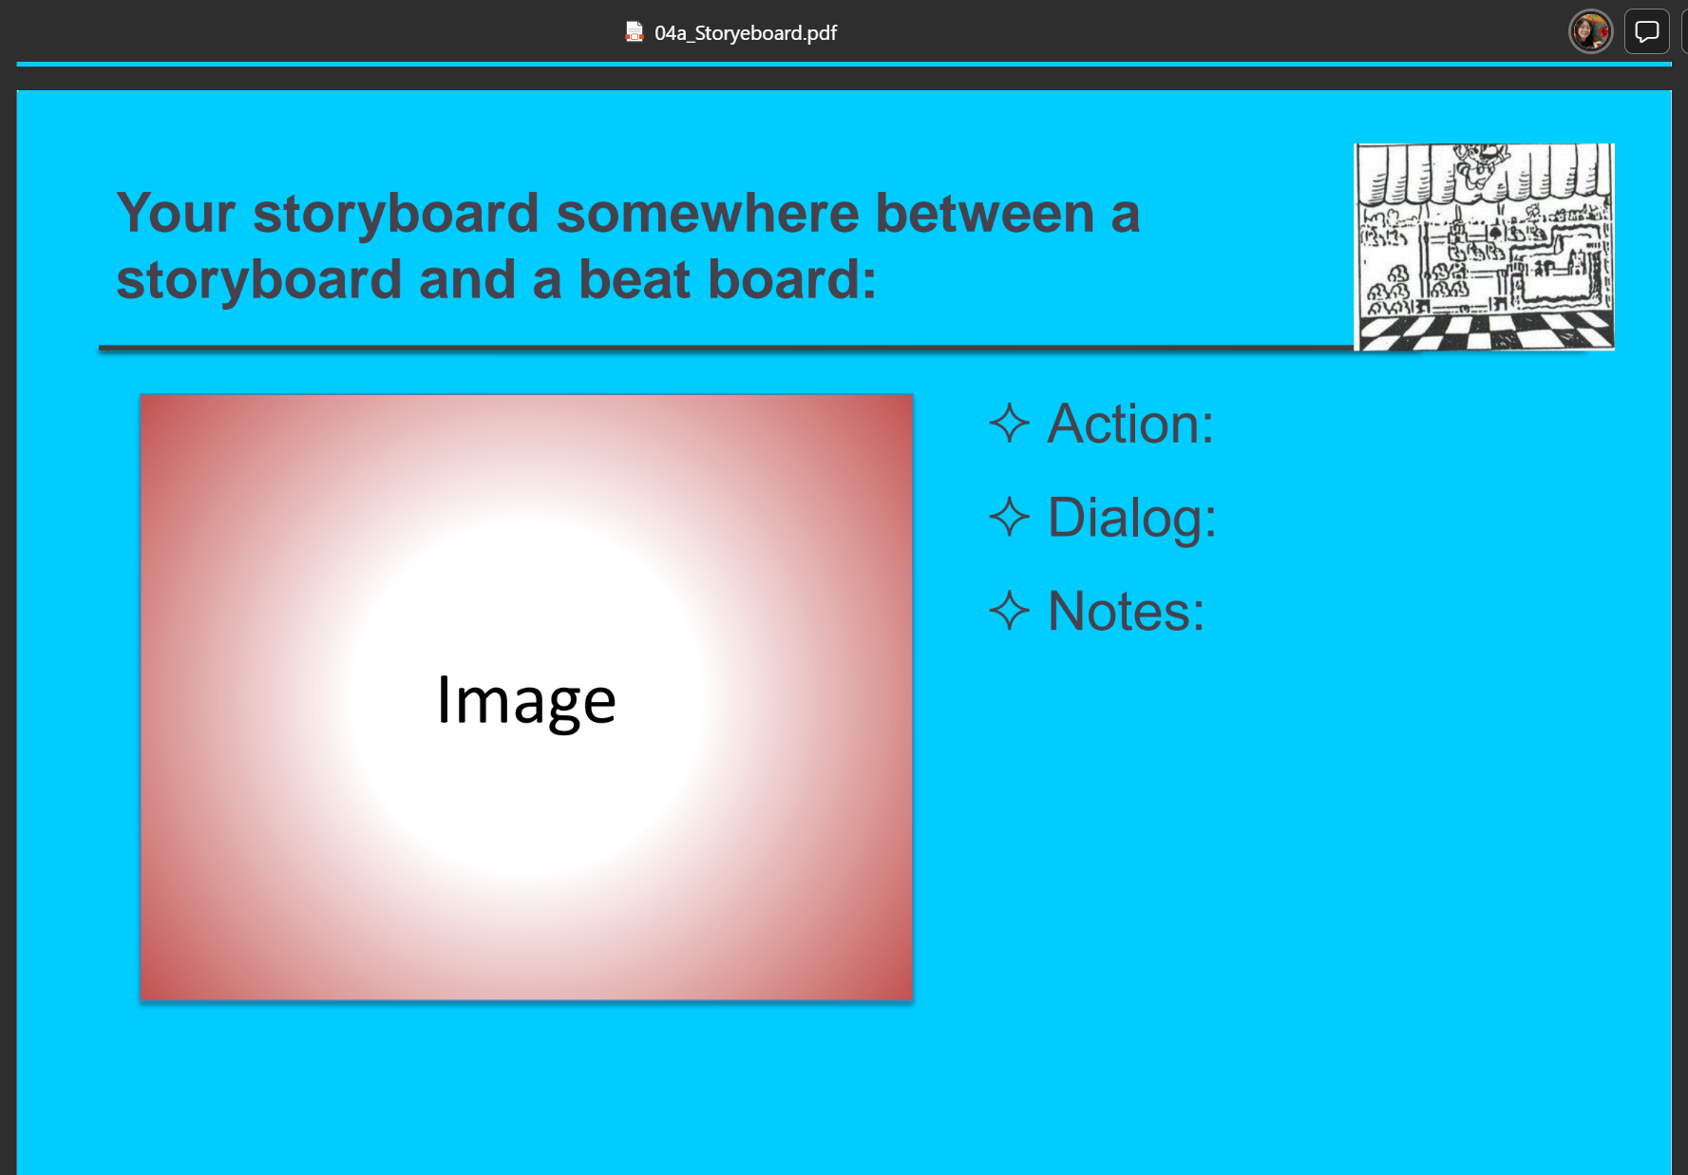
Scene 1: Main Menu
Action:
Selection of starting
main gameplay
Dialog:
None
Notes:
Background music

Slide 13
Scene 2: Character creator
Action:
Choose different options for character stats
Dialog:
None
Notes:
Background music

Slide 14
Scene 3: Prologue to game
Action:
Full screen dialogue that displays the start to the storyline.
Dialog:
Text on screen.
Notes:
Simple presentation of the prologue of the story.

Slide 15
Scene 4:Load tutorial scene
Action:
Navigation and combat controls are shown on screen and a direction is given to the first NPC encounter.
Dialog:
Text and arrows written on the ground.
Dialogue boxes had with the tutorial NPC.
Notes:
The first encounter is designed to demonstrate combat to the player before they move on.
All levels from this point onward can be returned to at will.

Slide 16
Scene 5: Load forest scene
Action:
Moving through the passageway allows the player to enter the next area.
Exploring this area to find the other NPCs
Dialog:
Multiple NPCs will be available for dialogue interactions.
Notes:
Several of these NPCs will be able to provide clues to the player.
These clues may not be obvious and must be read from the text.

Slide 17
Scene 6: Load lake scene
Action:
Navigation through the forest and around the lake to find additional NPCs.
Dialog:
Mercury is the closest planet to the Sun and the smallest one in the entire Solar System
Notes:
Mercury is the closest planet to the Sun and the smallest one in the entire Solar System

Slide 18
Scene 7: Load Lumberyard
Action:
An isolated area with only one NPC.
Dialog:
Speaking with the NPC about his task in the forest.
Notes:
Mercury is the closest planet to the Sun and the smallest one in the entire Solar System

Slide 19
Scene 8: Victory screens
Action:
Full screen dialogue box appears after win conditions are met.
Dialog:
Text on screen that explains ending achieved by the player.
Notes:
Three possible endings are planned depending on what has been achieved.

Slide 20
04
Data Flow Diagrams
You could enter a subtitle here if you need it

Slide 21
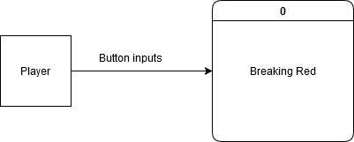
CONTEXT DIAGRAM

Slide 22
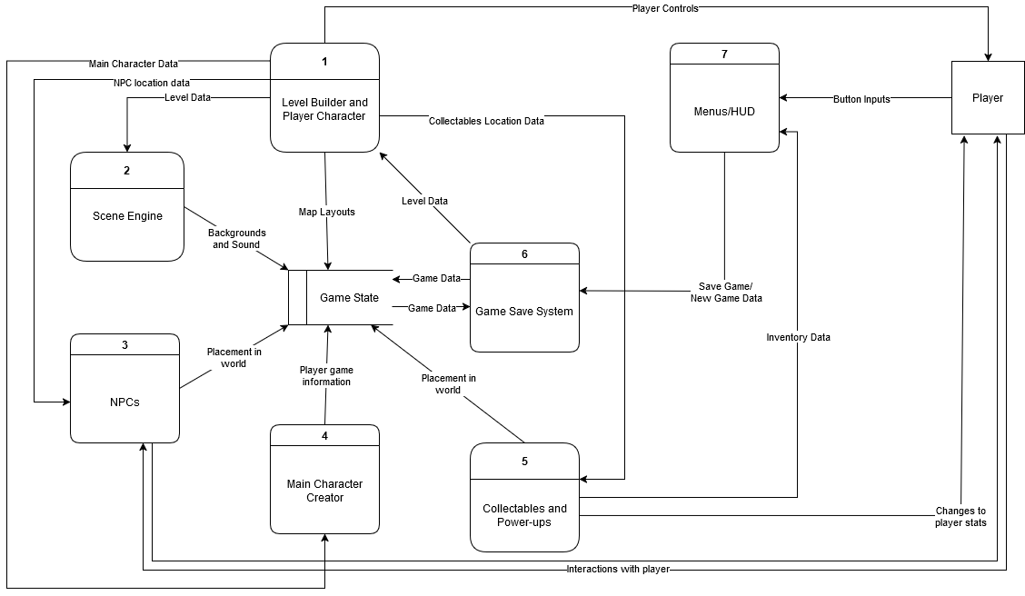
DIAGRAM 0

Slide 23
05
Global Use Case
You could enter a subtitle here if you need it

Slide 24
GLOBAL USE CASE

Slide 25
06
Individual Use Case
You could enter a subtitle here if you need it

Slide 26
Liz– feature

Slide 27
Liz Use Case

Slide 28
Alex– feature

Slide 29
Alex Use Case

Slide 30
Hengyi – SCENE ENGINE

Slide 31
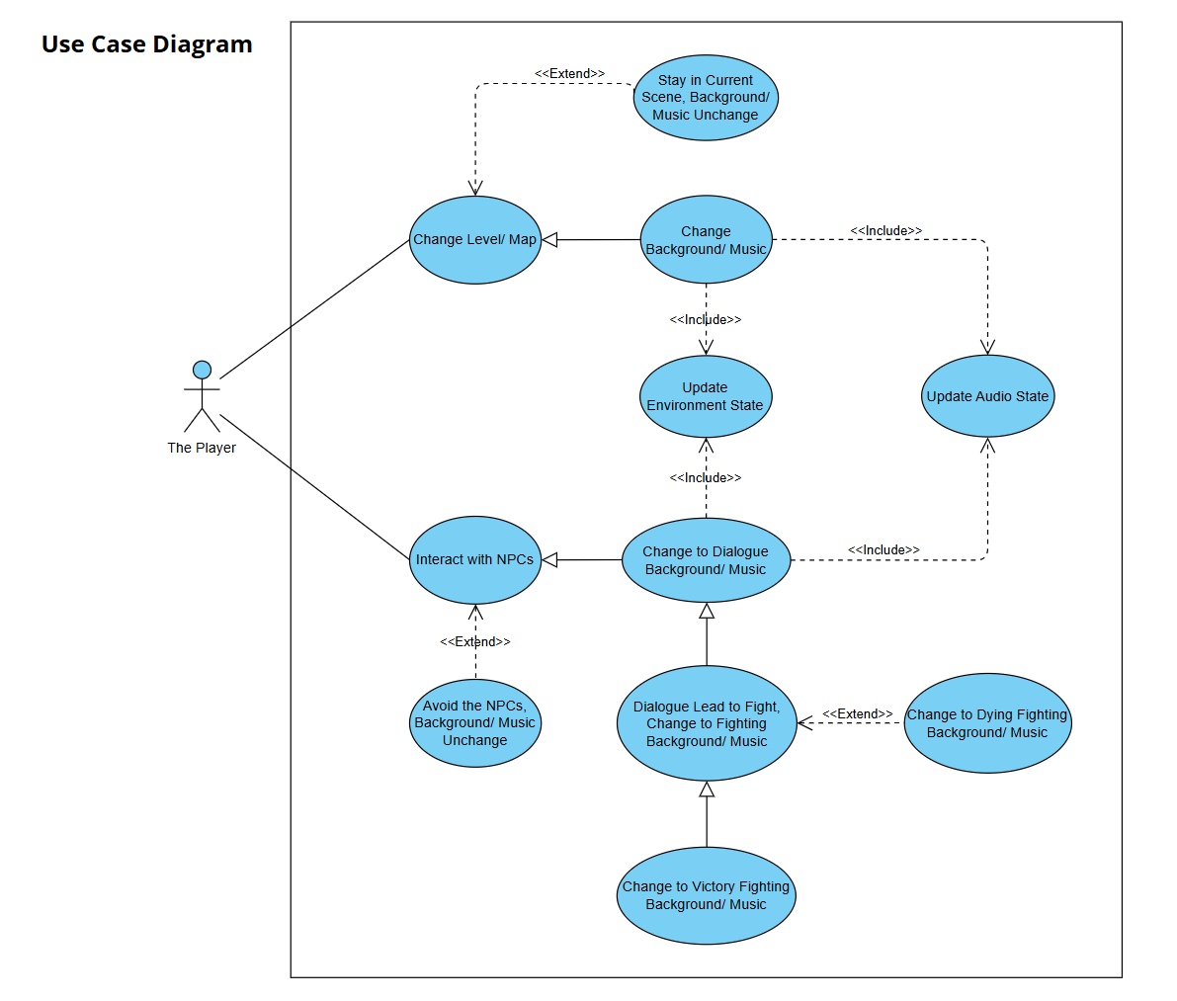
Hengyi Use Case

Slide 32
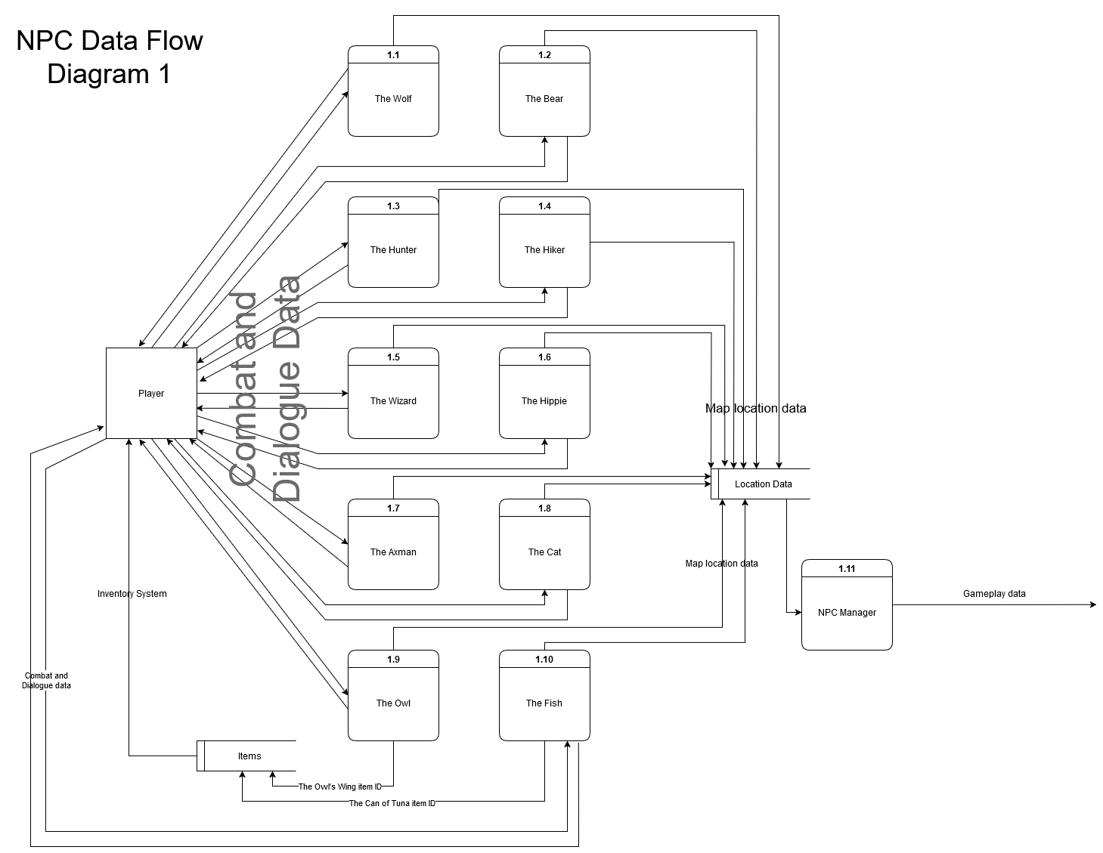
Todd – Feature Diagram 1

Slide 33
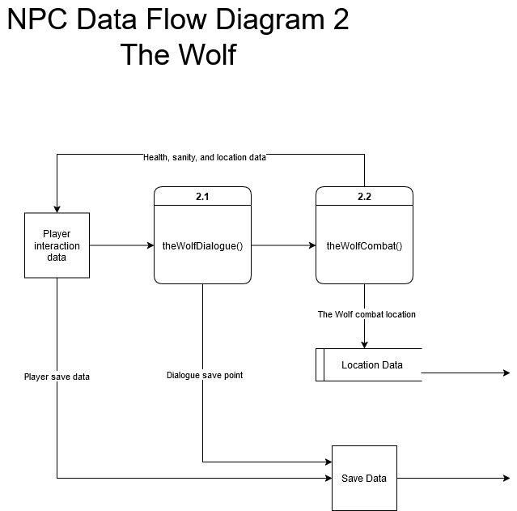
Todd – Feature Diagram 2

Slide 34
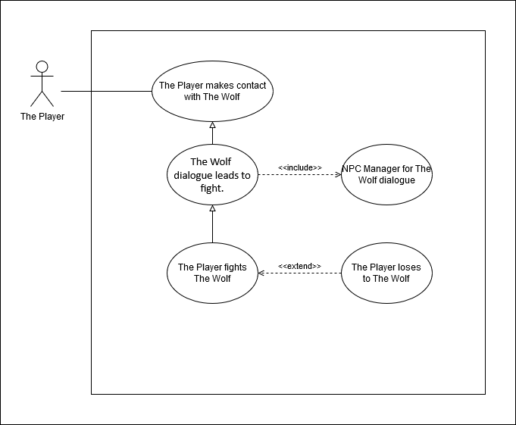
Todd - Use Case Diagram

Slide 35
Shan – feature

Slide 36
Shan - Use Case

Slide 37
name – feature

Slide 38
name Use Case

Slide 39
THANKS!
?
Do you have any questions?

Slide 41
CORE VALUES
MERCURY
JUPITER
Mercury is the smallest of them all
Jupiter is a gas giant planet
MARS
NEPTUNE
Mars is actually a cold place
Neptune is the farthest planet

Slide 42
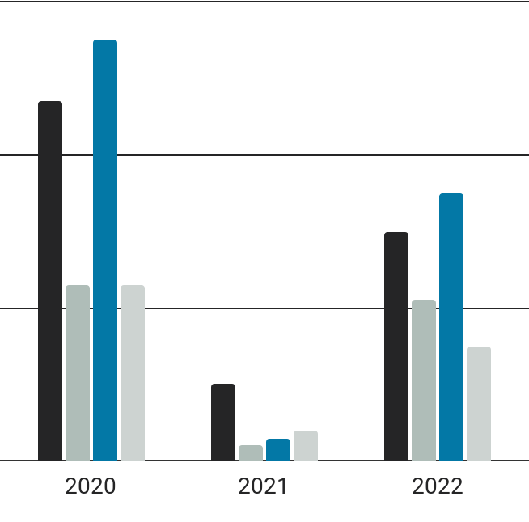
MARKET SHARE
MERCURY
3,000
Mercury is a small planet
MARS
2,100
Mars is a cold place
JUPITER
3,500
Jupiter is a gas giant
NEPTUNE
Follow the link in the graph to modify its data and then paste the new one here. For more info, click here
1,500
Neptune is an ice giant

Slide 43
CORE CUSTOMER AUDIENCE
LOCATION
AGE
26 - 40
60%
41 - 55
40%
INTERESTS
Venus
Mercury
Venus
Mars
Jupiter

Slide 44
COMPETITOR ANALYSIS
STRENGTHS
WEAKNESSES
You can list your competitor’s strengths here
You can list your competitor’s strengths here
You can list your competitor’s strengths here
You can list your competitor’s strengths here
You can list your competitor’s weaknesses here
You can list your competitor’s weaknesses here
You can list your competitor’s weaknesses here
You can list your competitor’s weaknesses here

Slide 45

MARKET SEGMENTATION
40%
25%
25%
10%
VENUS
EARTH
Venus has a beautiful name
Earth is the planet with life
MARS
PLUTO
Follow the link in the graph to modify its data and then paste the new one here. For more info, click here
Mars is actually a cold place
Pluto is considered a dwarf planet

Slide 46
STRATEGY
MARS
PLUTO
Mars is actually a very cold place
Pluto is considered a dwarf planet
01
02
03
04
VENUS
EARTH
Venus has a beautiful name
Earth is the planet with life

Slide 47
PRODUCT DESCRIPTION
MERCURY
A
Mercury is a small planet
GAME OVER
MARS
B
Mars is a cold place
JUPITER
C
Jupiter is a gas giant
NEPTUNE
D
Neptune is an ice giant

Slide 48
PRICING
$20
$22
$28
BASIC
PRO
PREMIUM
Mercury is the closest planet to the Sun
Saturn is a gas giant and has several rings
Venus is the second planet from the Sun

Slide 49
489,300
Big numbers catch your audience’s attention

Slide 50
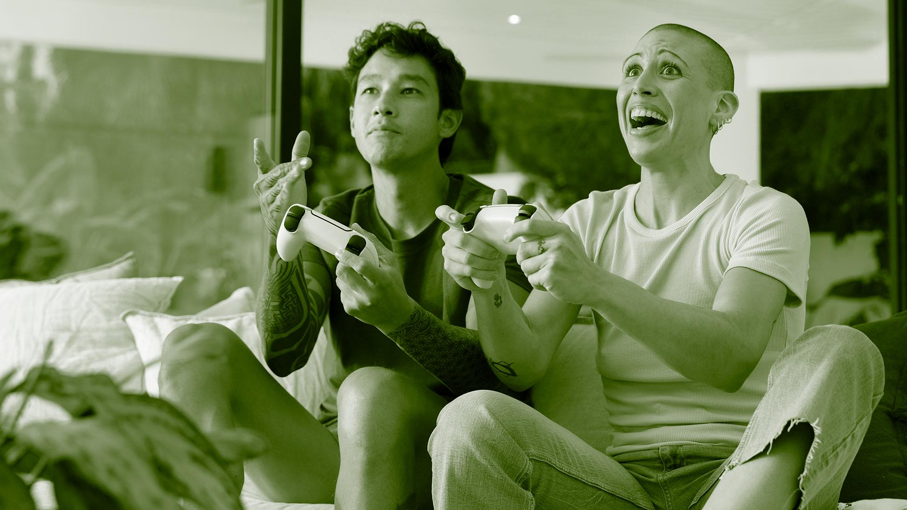
A PICTURE IS WORTH A THOUSANDS WORDS

Slide 51
An image reinforces the concept
Images reveal large amounts of data, so remember: use an image instead of a long text. Your audience will appreciate that

Slide 52
PROMOTION
MULTI
PRESS
APP
It’s the closest planet to the Sun
Venus is the second planet from the Sun
It’s the farthest planet from the Sun
DIGITAL
PODCAST
TV
Saturn is composed mostly of hydrogen
Jupiter is the biggest planet of them all
Despite being red, Mars is a cold place

Slide 53
ADVERTISING CAMPAIGN 1
Budget
25.000.000$
GOALS
You can list your goals here
You can list your goals here
CHANNEL
DESCRIPTION
Multimedia
Mercury is the closest planet to the Sun and the smallest one

Slide 54
ADVERTISING CAMPAIGN 2
CHANNEL
Budget
Press
500.000$
GOALS
ABOUT IT
You can list your goals here in this list
You can list your goals here in this list
Earth is the third planet from the Sun and the only one that harbors life in the Solar System

Slide 55
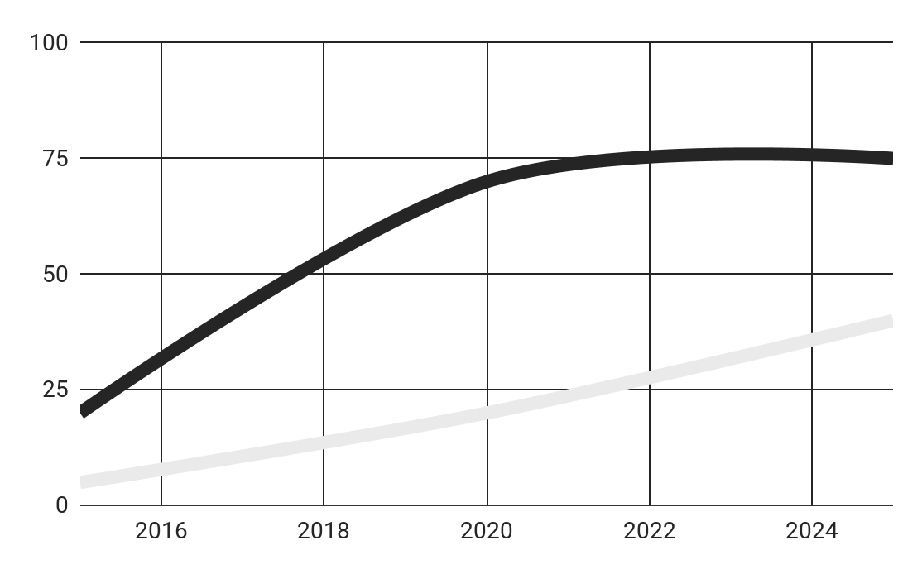
PREDICTED REACH
7,500
3,500
EARTH
Earth is the planet with life
PLUTO
Pluto is considered a dwarf planet
Follow the link in the graph to modify its data and then paste the new one here. For more info, click here

Slide 56
PR OUTREACH
CHANNELS
MESSAGES
GOALS
Venus is the second planet from the Sun
Mercury is the smallest of them all
Despite being red, Mars is a cold place
80%
Video
Saturn is a gas giant
60%
Mail
Venus is a hot planet
40%
Social
Mars is a cold place

Slide 57
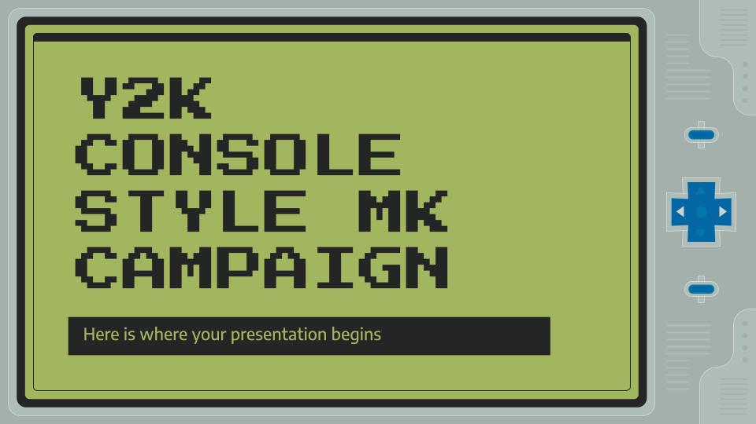
DIGITAL CONTENT
You can replace the image on the screen with your own work. Just right-click on it and select “Replace image”

Slide 58
BUDGET ALLOCATION
 | MARS | EARTH | VENUS
AREA 1 | 2.000$ | 3.100$ | 400$
AREA 2 | 3.400$ | 600$ | 200$
AREA 3 | 1.700$ | 800$ | 2.500$
AREA 4 | 4.000$ | 1.600$ | 800$

Slide 59

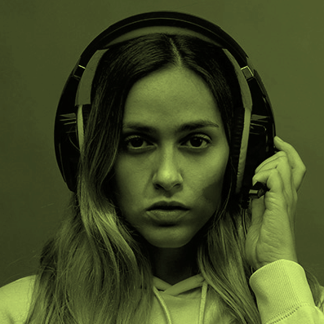
OUR TEAM
ANTHONY SHARP
OLIVIA PETERSON
Here you can talk a bit about this person
Here you can talk a bit about this person

Slide 60
TIMELINE
2020
2021
2022
VENUS
MARS
MERCURY
Venus is a extremely hot planet, even more than Mercury
Despite being red, Mars is actually a very cold place
Mercury is the closest planet to the Sun and the smallest one

Slide 61
THANKS!
Do you have any questions?

Slide 62
ALTERNATIVE RESOURCES
Here’s an assortment of alternatives resources within the same style of this template
Vintage video game consoles in flat design

Slide 63
RESOURCES
Did you like the resources? Get them for free at our other websites.
VECTORS
Vintage video game consoles in flat design
Futuristic background of a computer gamer
PHOTOS
Close-up boy playing with a game controller
Portrait of adult male playing video games
Girlfriend and boyfriend playing video games together
Young woman with pink hair playing a videogame
Man holding controller
Woman holding controller medium shot

